Slide 1
OCULAR DISEASE
Abdul Moiez
Fuad Ali Khowaja
Sanover Tasneem
Ramish Fatima

Slide 2
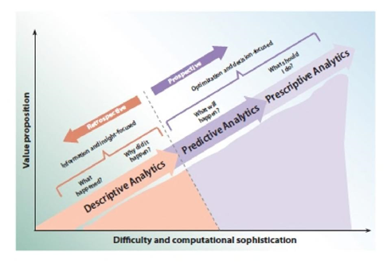
Analytics Hierarchy

Slide 3





DATASET OVERVIEW AND ITS IMPORTANCE
Data Source: Sourced from Kaggle, encompassing 6,400 records with 15 attributes each, including demographics, diagnoses, and fundus images.
Data Richness: The dataset reflects real patient interactions, capturing diverse ocular conditions across different demographic segments, crucial for accurate model training.
Relevance: Facilitates a detailed understanding of ocular disease patterns, which is instrumental for developing age and condition-specific predictive models.
Preparation: Rigorous data cleaning and preprocessing were performed to ensure model readiness.
Insight Potential: This dataset's depth allows for comprehensive exploratory and predictive analytics, targeting improved diagnostic and treatment approaches.

Slide 4
DRIVING PURPOSE BEHIND THE STUDY
Research Aim: To apply machine learning models to predict ocular disease classification and enhance patient segmentation for targeted treatment.
Objectives:
Identify patterns linking demographic and health factors to ocular disease prevalence.
Evaluate the effectiveness of various machine learning algorithms in disease prediction.
Develop a predictive framework that aids in personalized patient care and treatment plans.
Expected Impact: "Our research aims to contribute to the early detection of ocular diseases, improving diagnostic accuracy and patient outcomes in eye care

Slide 5
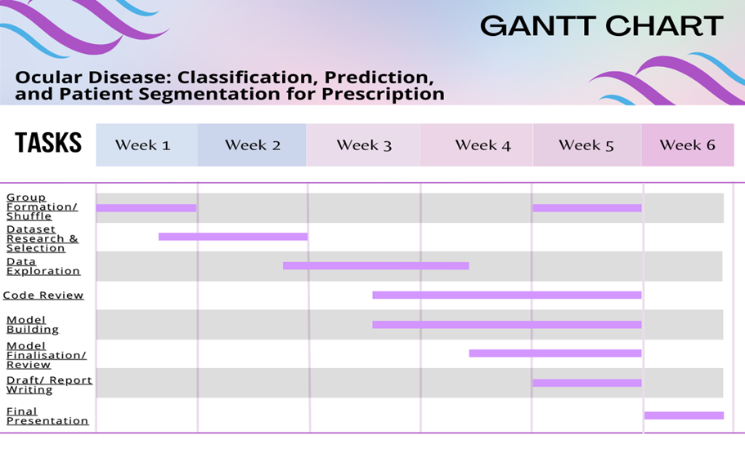
Gantt Chart

Slide 6

RESEARCH METHODOLOGY OVERVIEW - Business (APLC)
Data Preparation: Processed and cleaned dataset to ensure quality and relevance for analysis.
Exploratory Data Analysis (EDA): Conducted EDA to understand data distributions, trends, and relationships between variables.
Machine Learning Models:
Utilized a variety of models, including Logistic Regression, Decision Trees, Random Forest, and XGBoost, to predict ocular diseases.
Applied K-means clustering for patient segmentation based on disease types and risk factors.
Model Evaluation: Assessed models performance using accuracy, precision, recall, and F1-score, optimizing for the best predictive outcomes.
Insights & Predictions: Derived actionable insights for early detection and customized patient treatment plans.

Slide 7

PROCESS FLOW - Software Engineering (APLC)
Clean Encoding Issues
Duplicate Removal
Count the occurrences of each disease string by combining the two diagnostic keywords
Filter out the excluded strings and identify the top five most common disease occurrences
Create a dictionary mapping disease strings to shorter label strings and add new columns
Encode 'Patient Sex' as Binary
Select Columns for Correlation Analysis (Patient Age', 'Patient Sex', and all the binary disease flags)

Slide 8
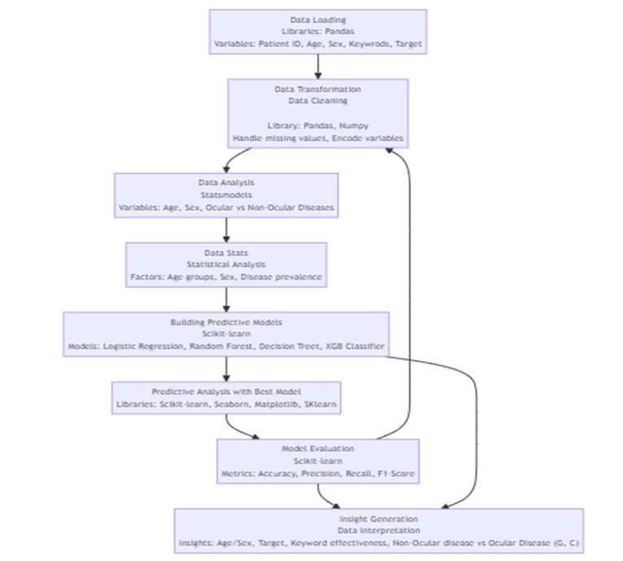
DATA FLOW - Business (APLC)

Slide 9
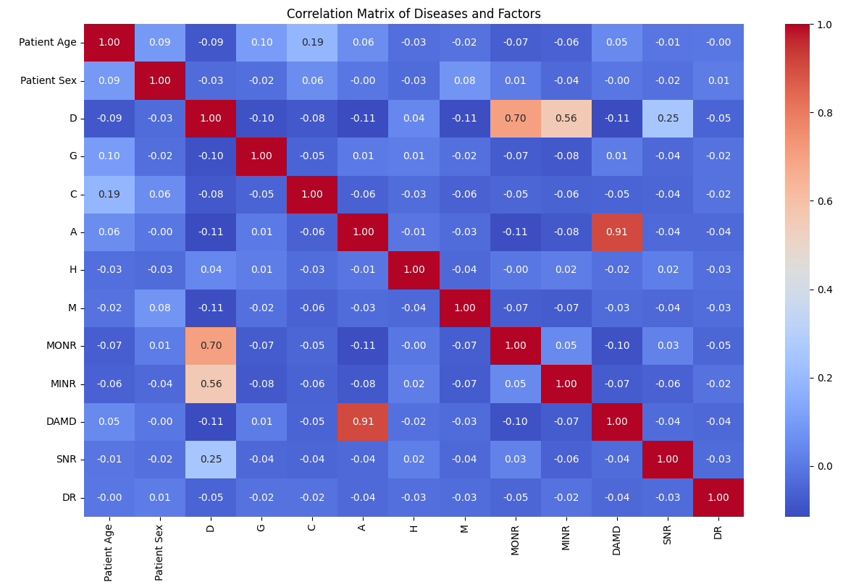
CORRELATION MATRIX

Slide 10





XGBOOST - Modelling (APLC)
Performance Edge: XGBoost is engineered for speed and improved performance, making it a preferred choice for large datasets and high-stakes predictive accuracy.
Handling Imbalance: With advanced algorithms, XGBoost effectively manages imbalanced datasets, which are common in medical data, ensuring more reliable disease classification.
Algorithm Sophistication: XGBoost uses gradient boosting frameworks that optimize predictive learning, often outperforming Random Forest's ensemble method.
Versatile Predictive Modeling: Capable of binary classification, multiclass classification, and regression, XGBoost supports a wide array of predictive tasks within the project.
Project Suitability: Given the complex nature of ocular disease data, XGBoost's robustness and versatility make it exceptionally suitable for this project's objectives.

Slide 11
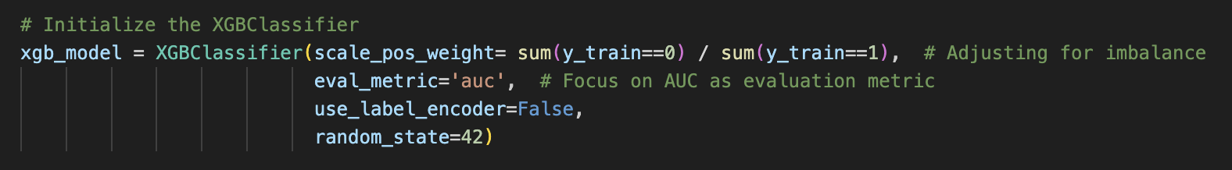
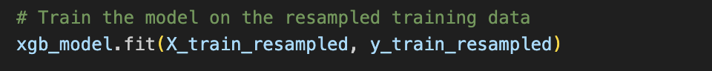
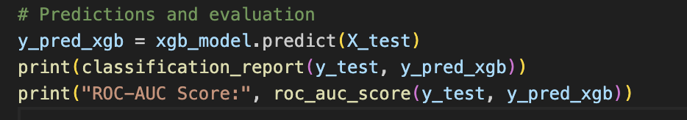
XGBOOST
Step 1: Initialize the XGBoost Classifier
Step 2: Train the XGBoost Model
Step 3: Make Predictions and Evaluate the Model

Slide 12
Disease Grouping / Models Used -
Left and Right Keywords:
MONR - Moderate Non-Proliferative Retinopathy
MINR - Mild Non-Proliferative Retinopathy
DAMD - Dry Age-related Macular Degenration
SNR - Severe Non-Proliferative Retinopathy
DR - Drusen
Models Used:
Logistic Regression
Decision Tree
Random Forest
XGBoost
NLP / K-means Clustering

Slide 13
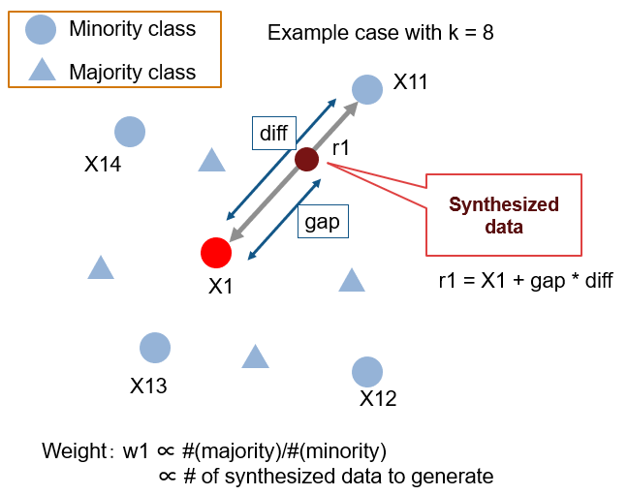
SMOTE - Modelling (APLC)
SMOTE is an oversampling technique that generates synthetic samples from the minority class. It obtains a synthetically class-balanced or nearly class-balanced training set, then trains the classifier.

Slide 14
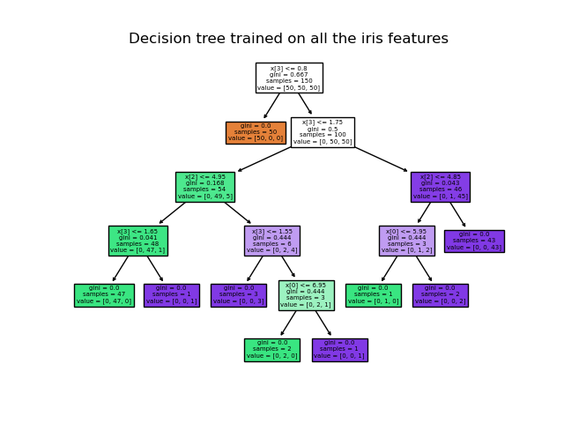
Decision Tree
Decision Trees (DTs) are a non-parametric supervised learning method used for classification and regression. The goal is to create a model that predicts the value of a target variable by learning simple decision rules inferred from the data features. A tree can be seen as a piecewise constant approximation.
Rules: If - then - else decision rules

Slide 15
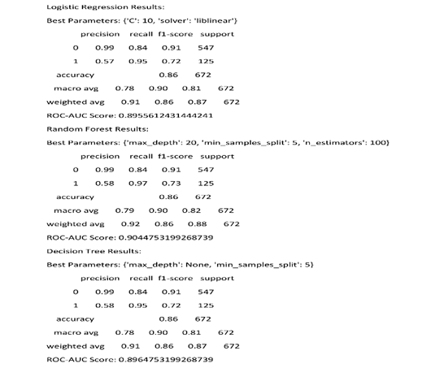
Output / Results

Slide 16
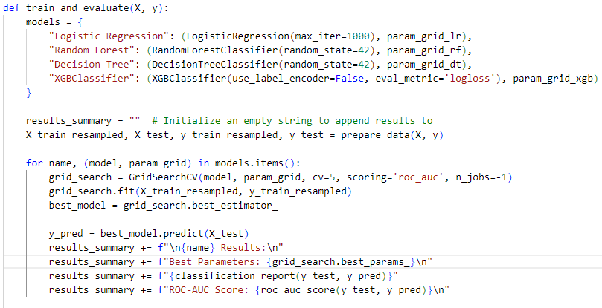
Model Pipelines
Our project uses a structured model pipeline to streamline the process of training, evaluating, and selecting machine learning models.
This pipeline approach models are handled and compared, for the project's long-term success and maintainability.
It allows comparison of multiple machine learning models by automating the hyperparameter tuning process through GridSearchCV.

Slide 17
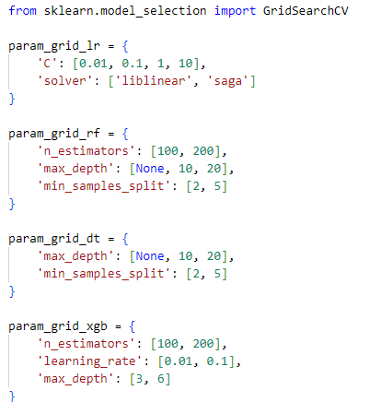
GridSearchCV
GridSearchCV is a powerful tool provided by the scikit-learn library in Python, designed to automate the process of tuning parameters of a model to find the best possible configuration for optimal performance.
Random Forest Tuning Parameters
Parameters: Number of trees (n_estimators), maximum depth of trees (max_depth), and minimum number of samples required to split an internal node (min_samples_split).
Value Range: n_estimators [100, 200], max_depth [None, 10, 20], and min_samples_split [2, 5].
Goal: Balance model complexity with prediction accuracy.

Slide 18
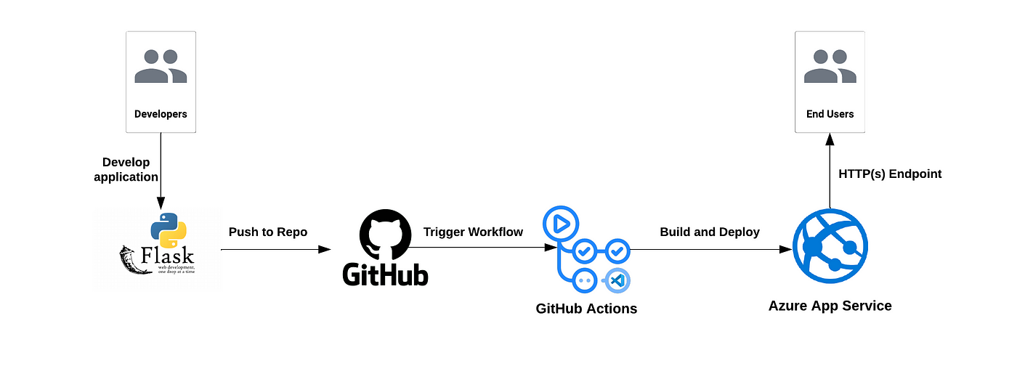
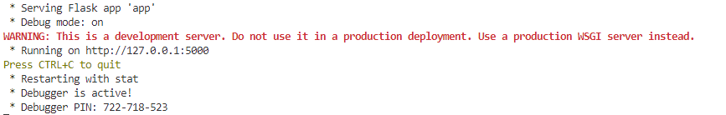
Integrating Flask App with Machine Learning Models

Slide 19
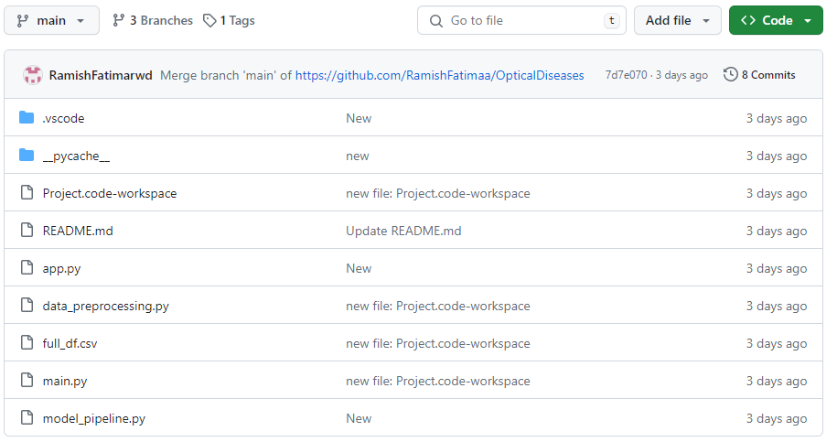
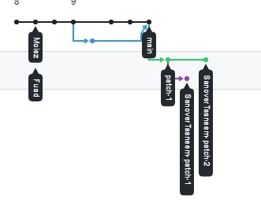
Integrating Flask App with Github
https://github.com/RamishFatimaa/OpticalDiseases.git

Slide 20
Software Development Practices
90%
85%
98%
Usability
Maintainability
Reliability
FUTURE: Interface with clear, navigable options for non-technical users
FUTURE: Modular design allows for independent updating of data processing and model evaluation components.
FUTURE: Error handling and validation prevent crashes and ensure the application behaves as expected.

Slide 21
Patient Stratification for Personalized Treatment
Disease Pattern Analysis through Text Mining
Implemented clustering algorithms i.e. K-means clustering to identify distinct subgroups or clusters of patients based on their disease profiles, demographic characteristics, and other relevant features.
By stratifying patients into distinct clusters, healthcare providers can gain insights into the heterogeneity of the patient population and tailor treatments or interventions based on the specific needs and characteristics of each cluster.
Personalized treatment plans can be developed for each cluster, taking into account factors such as disease severity, comorbidities, response to treatment, and risk factors.
Created a word cloud visualization to highlight the most frequently occurring and important words and diagnoses based on their frequency or significance.
Applied Latent Dirichlet Allocation (LDA) to identify latent topics or themes present in the medical notes and gain insights into the underlying structure of medical notes and identify recurring themes, patterns, and topics across different documents.
Built machine learning models (Logistic Regression) to classify medical notes into predefined categories or labels based on their content.

Slide 22
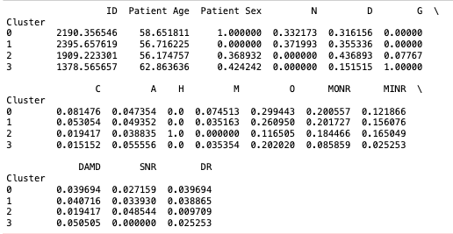
Patient Stratification for Personalized Treatment
Findings:
Cluster 0: Highest average patient age (58.65 years) with predominantly female patients. Dominant diseases: drusen (29.94%), diabetes (33.22%), and glaucoma (31.62%). Moderate nonproliferative retinopathy (MONR) observed in 20.06%.
Cluster 1: Slightly lower average age (56.72 years) with predominantly male patients. Dominant diseases: diabetes (37.20%), glaucoma (35.53%), and drusen (26.10%). MONR observed in 20.17%.
Cluster 2: Lowest average age (56.17 years) with a balanced distribution of male and female patients. Dominant diseases: hypertension (77.67%), age-related macular degeneration (43.69%), and diabetes (36.89%). MONR observed in 18.45%.
Cluster 3: Slightly higher average age (62.86 years) with predominantly male patients. Dominant diseases: diabetes (42.42%) and drusen (100%). MONR observed in 8.59%.
Healthcare providers can tailor treatment plans based on cluster characteristics: Address diabetes, glaucoma, and drusen in Clusters 0 and 1, while focusing on hypertension and age-related macular degeneration in Cluster 2. Prioritize diabetic retinopathy screening in high-risk subgroups based on MONR prevalence across clusters.

Slide 23
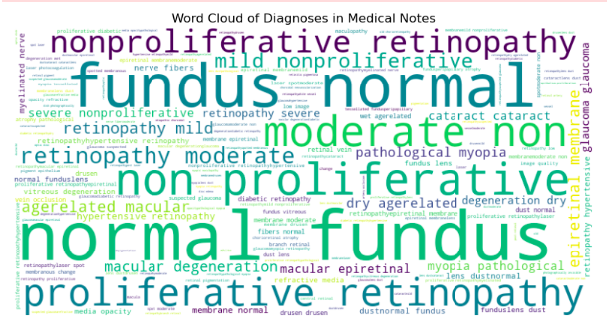
Disease Pattern Analysis Using Word Cloud
Findings:
Prominent Terms (Big Font): Nonproliferative retinopathy, proliferative retinopathy, macular degeneration, glaucoma, dry age-related macular, pathological myopia, diabetes retinopathy.
Less Common Terms (Small Font): Dustnormal fundus, drusen, membrane normal, media opacity, lens dustnormal, hypertensive retinopathy, vitreous degeneration, myelinated nerve, refractive media, low image, laser spot moderate.
Notable mentions include retinopathy variations, age-related macular degeneration, glaucoma, and diabetes retinopathy, indicating their prevalence and significance in patient records.
Less common terms provide additional context, such as fundus abnormalities and retinal conditions, contributing to a comprehensive understanding of patient health profiles.

Slide 24
Topic Modelling and Classification Using Medical Notes
Findings:
Topic 0 (Eye Conditions and Treatment): Identified terms are glaucoma, pathological myopia, retinopathy, laser, moderate, proliferative. The presence of terms like "laser" and "moderate" suggests conversations regarding treatment options and disease severity assessment.
Topic 1 Age-Related Macular Degeneration (AMD): Identified terms are drusen, dry, epiretinal membrane, age-related macular degeneration (AMD). These terms commonly relate to retinal disorders and degenerative changes in the macula.
Topic 2 (Diabetic Retinopathy): Identified terms are diabetic, nerve fibers, nonproliferative retinopathy, severe, hypertensive, mild. Terms such as "severe" and "mild" may indicate discussions on disease progression or severity levels in diabetic patients.
Healthcare professionals can use this information to focus on specific areas of interest, such as treatment options for eye conditions, management strategies for age-related macular degeneration, and interventions for diabetic retinopathy.
The model correctly classified approximately 84.97% of the instances in the test dataset.
This means that out of all the medical notes in the test dataset, about 84.97% were correctly classified into their respective categories or labels.
This suggests that the text classification model is performing reasonably well.

Slide 25
APLC - Analytics Product Life Cycle
Quadrants | Stages | APLC Activities
Business | Project Right Sizing and Framing | Objectives and Research Questions
 | Evaluate Culture | Identified working with ML Models
 | Identify a Sponsor | Instructors Mid Check Point
 | Create a Team | Formed Diversified Team - Week 1-2
Data Engineering | Data Collection & Management | Data Acquisition and Processing - Used .csv file from Kaggle
Modeling | Advanced Analytics | Data Splitting / Pipelines
 | Validate, Verify, Iterate | Reviewing Code on Local Host / GitHub Repository / Creating Branches
Software Engineering | Implement, Test, Iterate | Reviewing Data Flow and Code Integration
 | Embedded Analytics | Final Check and Deployment - GitHub

Slide 26
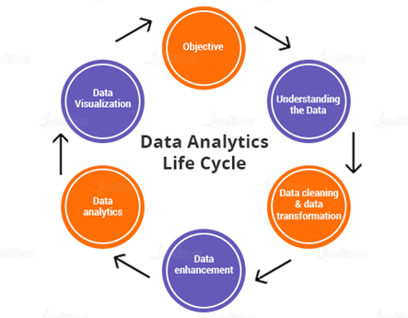
Data Life Cycle
UAP* - Data Enhancement - Alterations in the data

Slide 27
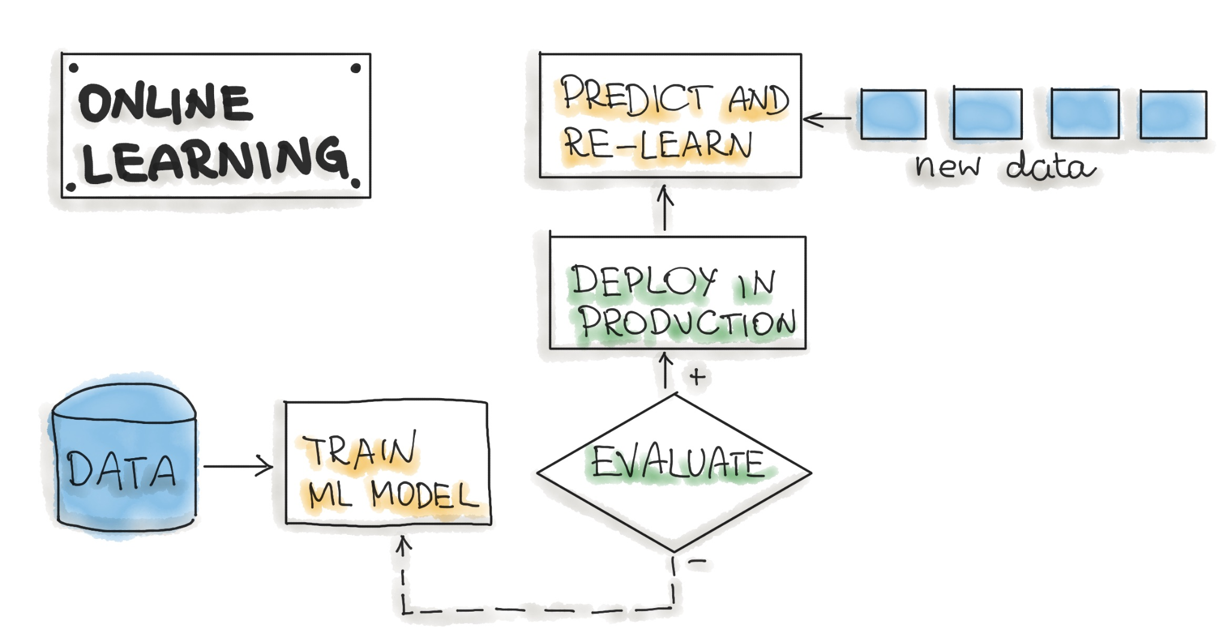
MLOPs
Deployment* - Local Host - IP Address

Slide 28
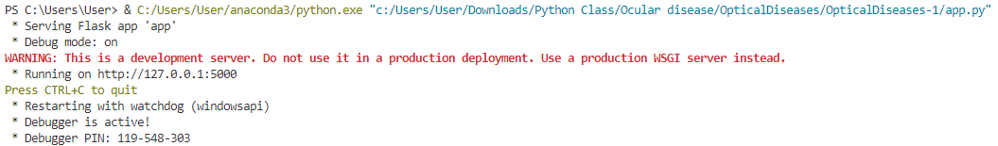
MLOPs - Continued
Deployment* - Local Host - IP Address

Slide 29

Key Takeaways
Age-related Patterns: Identified age-specific susceptibilities to ocular diseases.
Impact of Non-Ocular Diseases: Highlighted influence of conditions like diabetes on ocular health.
Predictive Modeling: Random Forest model emerged as best for disease prediction.
Personalized Interventions: K-means clustering enabled tailored treatments for patient subgroups.
Insights from Text Mining: NLP techniques provided valuable insights from medical notes, aiding in early detection and targeted interventions.

Slide 30
Thank You.

